Slide 1
Capstone Project 3
Cardiovascular Risk Prediction
By:- Tushar Yuvraj Khairnar

Slide 2

Content:
Problem Statement
Data Summary
Handling Missing Values
Exploratory Data Analysis (EDA)
Multicollinearity
Data Processing
Modelling Approach
Predictive Model
Model Comparison
Conclusion

Slide 3

Abstract:
Cardiovascular disease (CVD) is a group of disorders of the heart and blood vessels and includes coronary heart disease, cerebrovascular disease and other conditions.
Cardiovascular diseases (CVDs) are the leading cause of death globally, taking an estimated 17.9 million lives each year.
Though CVDs cannot be treated, predicting the risk of the disease and taking the necessary precautions and medications can help to avoid severe symptoms and, in some cases, even death.

Slide 4

Problem Statement:
The goal of the project is to develop a classification model that can predict whether a patient is at risk of coronary heart disease (CHD) over the period of 10 years, based on demographic, lifestyle, and medical history.
The data was gathered from 3390 adults participating in a cardiovascular study.in a cardiovascular study

Slide 5
Data Summary:
There are 3390 rows and 16 different attributes (columns) in the dataset.
Dependent Variable: TenYearCHD
Current Medical status:
Total cholesterol
BMI
Heart Rate
Glucose
Systolic BP
Diastolic BP
Demographic Data:
Sex
Age
Education
Medical History:
BP medication
Prevalent hypertension
Prevalent stroke
Diabetes
Behavioural:
Is smoking
Cigarettes per day

Slide 6
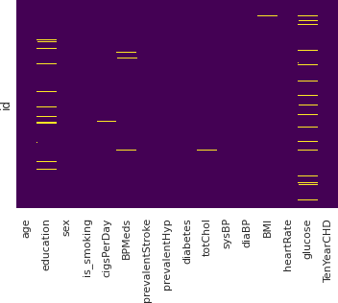
Handling Missing Values:
In the data, there were some columns which have missing values (Education, cigsPerDay, BPMeds, Totchol, BMI, heartrate, glucose).
Missing Values imputed by the aggregate (mean or median).
Mean imputation Education(87), totChol(38)
Median imputation CigPerDay(22), BMI(14), Glucose(304)
Mode imputation BPMeds(44)
heartRate column has only one missing value hence I dropped that missing value row.

Slide 7
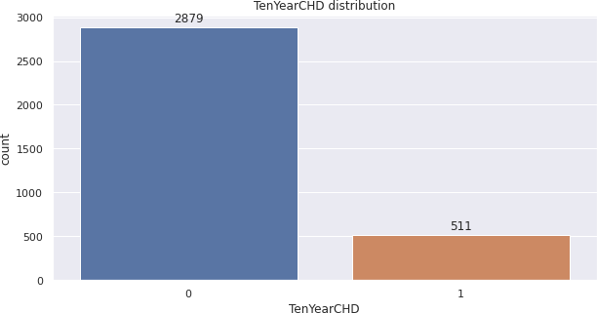
Exploratory Data Analysis (EDA):
The dependent variable - 10 year risk of
CHD is Imbalanced.
Only 15% of the patients in the study were eventually exposed to the risk of this heart disease, rest of the patients were not exposed to this disease after the end of 10 year study.
All the continuous independent variables are positively skewed except age, which is almost normally distributed.

Slide 8
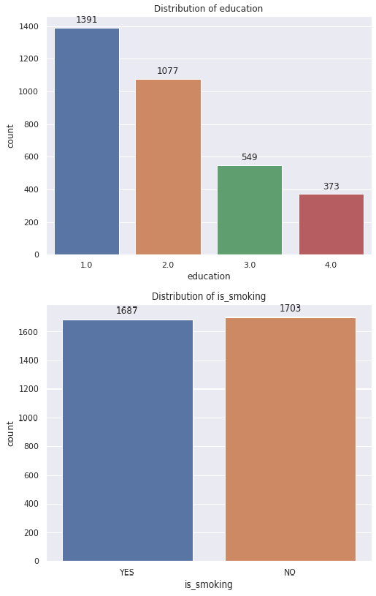
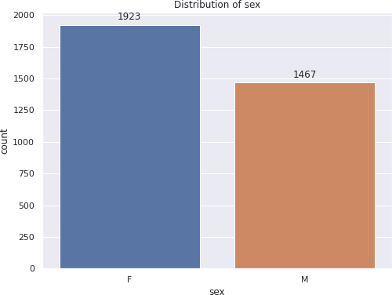
EDA:
Distribution of the categorical variables:
There are more female patients compared to male patients.
Majority of patient belong to the education level 1.
Half the patient are smokers.

Slide 9
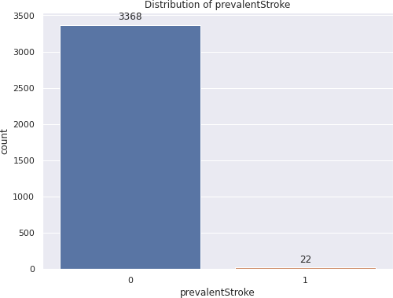
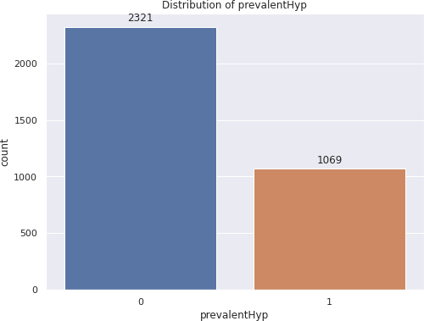
EDA:
Distribution of the categorical variables:
There are relatively few individuals who
have experienced a stroke
Of the total participants, 31.53% had prevalent hypertension.

Slide 10
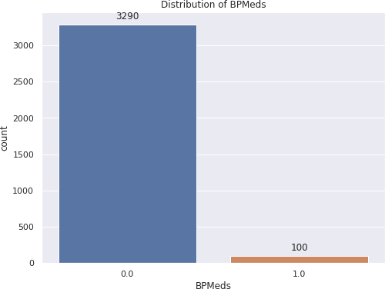
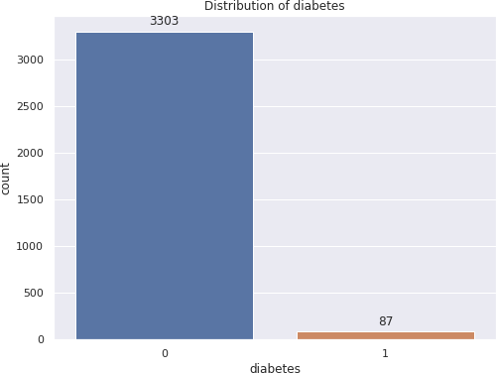
EDA:
Distribution of the categorical variables:
Of the total participants, 100 participants were
under blood pressure medication.
There are relatively few participants who have
diabetes.

Slide 11
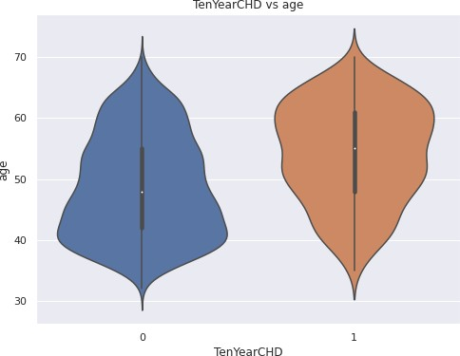
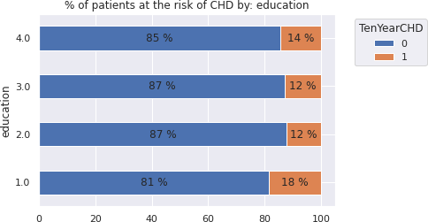
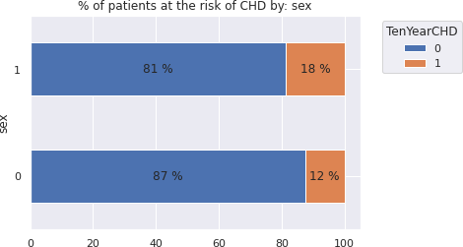
EDA:
The relation between dependent variable and independent variables:
The risk of CHD increases with the age.
The risk of CHD varies by education level and gender.

Slide 12
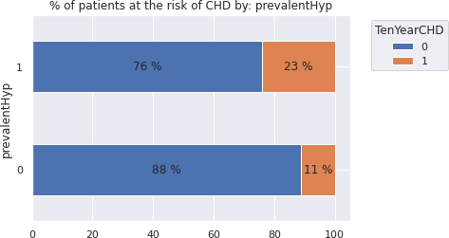
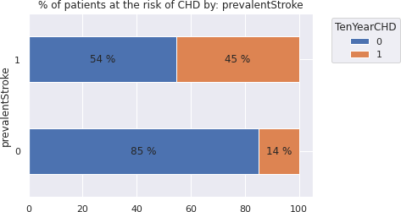
EDA:
The relation between dependent variable and independent variables:
Patients who have had a stroke or hypertension are more likely to test positive for CHD.

Slide 13
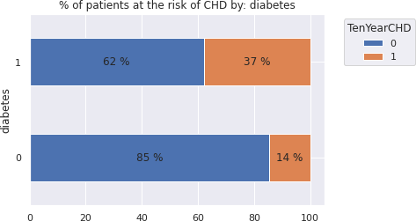
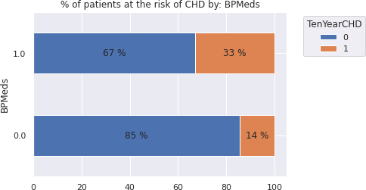
EDA:
The relation between dependent variable and
independent variables:
Patients with diabetes or are presently on blood pressure medication are more likely diagnosed with CHD.

Slide 14
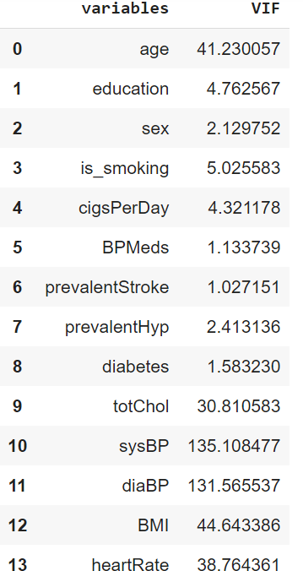
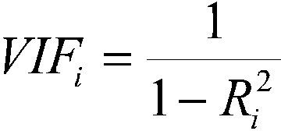
Multicollinearity:
Variance Inflation Factor(VIF) is a measure of collinearity among predictor variables.
systolic pressure and diastolic pressure have higher VIF.
Added new feature Pulse Pressure.
Pulse pressure = (systolic pressure - diastolic pressure)

Slide 15
Data Processing:
Transform data to reduce skewness:- The values of a certain independent variable (feature) are skewed, depending on the model, skewness may violate model assumptions or may impair the interpretation of feature importance. Hence log transformations used to transform skewed data.
Handling outliers:- (Mean/Median imputation) As the mean value is highly influenced by the outliers, it is advised to replace the outliers with the median value.
Handling imbalanced data:- Since we are dealing with imbalanced data, SMOTE (Synthetic Minority Oversampling Technique) is used to oversample train data.
Scaling the data:- StandardScaler removes the mean and scales the data to the unit variance.

Slide 16
Model Selection Approach:
We are working on a binary classification problem.
Standard binary classification models like Naive Bayes, decision tree classifiers, ensemble of decision tree and support vector machines.
Choice of split:- k fold cross validation k=5.
Hyperparameter tunning:- GridsearchCV
Evaluation Metrics:- since we are dealing with data related to healthcare, False Negatives are
big concern than False Positives. The recall score would be the best evaluation metric.
Recall = TruePositives / (TruePositives + FalseNegatives)

Slide 17
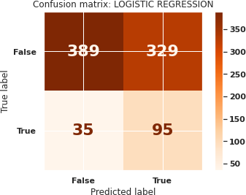
Logistic regression:
Evaluation Metrics:
Recall:
Test Recall = 0.7307
Confusion Metrics:
There are 35 False Negative.

Slide 18
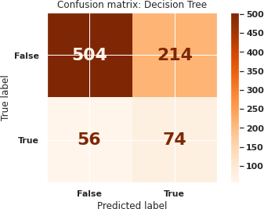
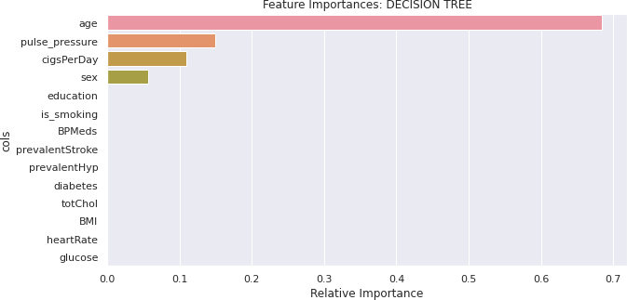
Decision Tree Classifier:
Parameters:
max_depth = 4
min_samples_leaf = 0.1
min_samples_split = 0.1
Evaluation Metrics:
Recall:
Test Recall = 0.5692
Confusion Metrics:
There are 56 False Negative.

Slide 19
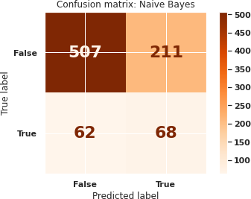
Naive Bayes Classifier:
Parameters:
var_smoothing = 1.0
Evaluation Metrics:
Recall:
Test Recall = 0.5230
Confusion Metrics:
There are 62 False Negative

Slide 20
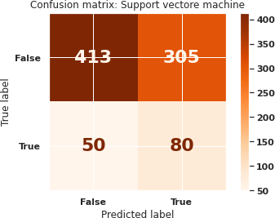
Support Vector Machine (SVM):
Parameters:
kernel = rbf
gamma = 0.01
C = 10
Evaluation Metrics:
Recall:
Test Recall = 0.6153
Confusion Metrics:
There are 50 False Negative.

Slide 21
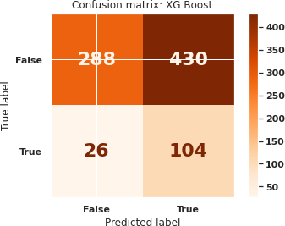
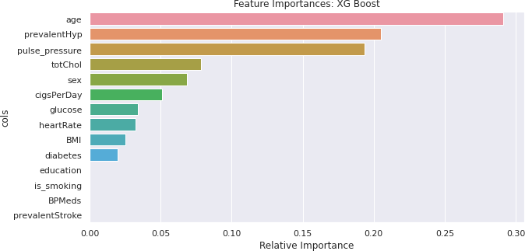
XG Boost:
Parameters:
max_depth = 1
min_samples_leaf = 0.1
min_samples_split = 0.1
n_estimators = 500
Evaluation Metrics:
Recall:
Test Recall = 0.80
Confusion Metrics:
There are 26 False Negative.

Slide 22
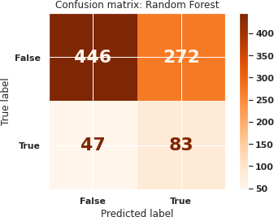
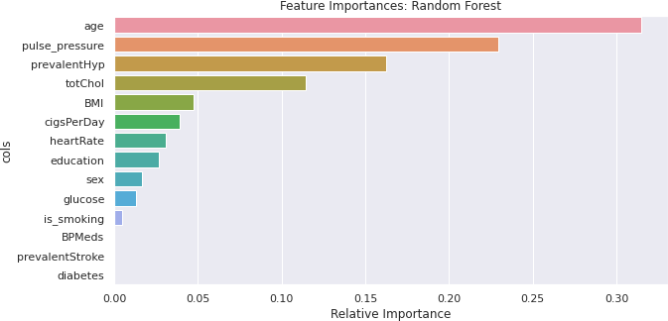
Random Forest:
Parameters:
max_depth = 2
min_samples_leaf = 0.1
min_samples_split = 0.1
n_estimators = 500
Evaluation Metrics:
Recall:
Test Recall = 0.6384
Confusion Metrics:
There are 47 False Negative

Slide 23
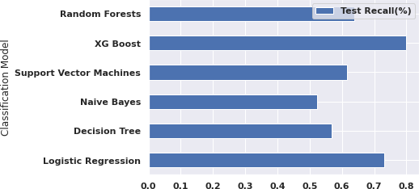
Model Comparison:
The XG Boost model has the highest test recall compare to other models.

Slide 24
Conclusion:
Predictive models have been successfully built, that can predict a patient's risk for CHD based
on their demography, lifestyle, and medical history.
The Built models were evaluated using Recall, and the XG Boost (0.80) has the highest test recall compared to other models.
A recall score of 0.80 indicates that out of 100 individuals with the illness, our model will be
able to classify only 80 as high-risk patients, while the remaining 20 will be misclassified.
From the analysis, I found that the age of a person was the most important feature in determining the risk of a patient getting infected with CHD, followed by pulse pressure, prevalent hypertension and total cholesterol.
Diabetes, prevalent stroke and BP medication were the least important features in determining
the risk of CHD.

